Slide 1
Csci465: Principals of Translations
Chapter 2
UND School Of Electrical Engineering & Computer Science
Dr. Hassan Reza

Slide 2
Objectives
Overview of front-end compiling technique
Context-free grammar
Parse Trees
Intermediate code generation
Syntax-Directed Translation (SDT)
A simple grammar-oriented translating technique
SDT is used to translate infix arithmetic expression into postfix expression

Slide 3
Overview
Analysis/Synthesis (revisited)
Analysis phase breaks up a source program into tokens
Generates intermediate code
Analysis part concerns with syntax of PL
A Programming Language can be defined
Syntax (precise form)
Semantics (meaning, difficult to specify)
Syntax represented
BNF (EBNF)
Semantics can be
Informal description

Slide 4
translation
Key Translation phases are
Analysis phase (front-end)
Synthesize phase (back-end)
Analysis phase works with “syntax” of the language

Slide 5
A model of a compiler front-end
Lex
parser
Intermediate Code
Generator
Char stream
tokens
Syntax
tree
3-address code
Symbol Table

Slide 6
Lexical analyzer
Lexical (or Lex)
Breaks down the stream of characters (e.g., identifiers) into tokens
E.g.,
Input: Position+ 1
Output: <ID, position> <plus-sign +> <Num, 1>

Slide 7
Intermediate Code generators (IC)
Two forms of Intermediate code representations
Syntax-tree, which represents the hierarchical syntactic structure of the source program
Three-address code, which is alinear representation of the three-address instructions
About three-address code
It carries ONLY one operators and takes the following form
X = Y OP Z where
OP is binary operator
Y and Z are addresses for operand
X is the address of the result

Slide 8
IC: syntax Tree and 3-address code
“Do I = I +1; while (a[i] < v);”
do-while
1: i = i + 1
2: t1 = a [i]
3: if t1 < v goto 1
body
<
B: 3-address code
assign
[ ]
v
i
+
a
i
i
1
A: syntax tree

Slide 9
Syntax of PL: Context-free grammar (CFG)-1
Syntax of programming languages?
the set of rules that defines the combinations of symbols that are considered to be a correctly structured document
Programming language syntax is generally distinguished into three levels:
Words: the lexical level, determining how characters form tokens
Phrases: the grammar level, narrowly speaking, determining how tokens form phrases
Context: determining what objects or variables names refer to, if types are valid, etc.
Notes:
Languages generated by context-free grammars are known as context-free languages (CFL). Different context-free grammars can generate the same context-free language. It is important to distinguish the properties of the language (intrinsic properties) from the properties of a particular grammar (extrinsic properties). The language equality question (do two given context-free grammars generate the same language?) is undecidable.
Context-free grammars arise in linguistics where they are used to describe the structure of sentences and words in a natural language, and they were in fact invented by the linguist Noam Chomsky for this purpose, but have not really lived up to their original expectation. By contrast, in computer science, as the use of recursively-defined concepts increased, they were used more and more. In an early application, grammars are used to describe the structure of programming languages. In a newer application, they are used in an essential part of the Extensible Markup Language (XML) called the Document Type Definition.^{[2]}

Slide 10
How to specify Syntax Definition?
How to specify syntax?
Context Free Grammar (CFG)
About CFG
Invented by Noam Chomsky
Used to guide the translation
e.g., Syntax-directed translation

Slide 11
Context-free grammar: 1
Context-free grammar is used to specify the syntax or grammar
E.g., if-else in Java
If (expression) statement else statement
Can be represented in CFG
stmt→ if ( expr) stmt else stmt
Stmt, expr are variables (nonterminal)
If, else,(, ) are else are terminals

Slide 12
Context Free Grammar: Definition
A context-free grammar consists of
A set of tokens known as terminals
A set of non-terminals
A set of production rules
A start symbol
The grammars are specified by listing their productions

Slide 13
Example 2.1 : Productions
CFG to describe expressions such as “list’:
list →list + digit
list →list – digit
list →digit
digit →0|1|2|3|4|5|6|7|8|9
The above set of rules can be rewritten:
list →list + digit| list – digit | digit
The terminals ={0,1,2,3,4,5,6,7,8,9,0,+,-}

Slide 14
Derivations
A grammar derives strings (input) when starting from the goal symbol and rewriting a left-hand-side(LHS) by the right-hand-side (RHS)
The process generates terminal strings conforms to the language specification
The terminal strings represent the language specified by the grammar

Slide 15
Example 2.2: lists
Using the language defined by the grammar, lists can be defined as a sequence of digits separated by ‘+’ and ‘-’ signs and other digits
E.g., given 9-5+2 , we can deduce it is a list using the CFG of “list”
9
< a digit is a list using Rule 3>
9-5
<a list using Rule 2>
9-5+2
<a list using Rule 1 >

Slide 16
Example 2: Productions for Procedure call
Using CFG to define the list of parameters in function call
call → id (optparams)
optparams → params | ɛ
params →params, param| param

Slide 17
Parsing
Parsing?
It is a process of taking a string of terminals as input and try to derive it from the start symbol of the grammar
report syntax error if it cannot be driven from start symbol

Slide 18
Parse Tree
Parse Tree (PT)?
shows graphically how the start symbol of a grammar derives a string in the language
Formally, given CGF, a PT is a tree consists of
the root (start symbol)
Interior nodes (non-terminal)
leaf nodes (terminals or ɛ)

Slide 19
Example of PT for input 9-5+2
CFG for lists
list →list + digit
list →list – digit
list →digit
digit →0|1|2|3|4|5|6|7|8|9
Terminals = { +, -, 0, 1,2,3,4,5,6,7,8,9}
list
list
digit
list
digit
digit
9
5
2
-
+

Slide 20
Ambiguous grammar?
Grammar should be precise or it may have multiple interpretation
Ambiguous grammar?
A grammar having two or more PTs for the same strings
Suppose we have the following grammar
string→ string + string| string – string| 0|…|9

Slide 21
Input = (9-5)+2=6
Ambiguous grammar:
string→ string + string| string – string| 0|…|9
string
string
+
string
string
-
string
9
5
2

Slide 22
Input = 9-(5+2)=2
string→ string + string| string – string| 0|…|9
string
string
-
string
9
string
+
string
5
2

Slide 23
PT: Associatively of Operators
Associatively of Operators
9+5+2 ≡ (9+5) +2 (left associate)
9-5-2 ≡ (9-5) -2 (left associate)
left associate operators:
(+,-,*,/)
Right associate operators:
Exponential
Assignment statements in C (a=b=c=d)

Slide 24
Precedence of Operators: 1
For 9+5*2, two interpretations:
(9+5)* 2
9+(5*2)
Associatively rules do not help us because operators are not the same
Precedence rules for operators are needed
“*” has higher precedence than “+” if “*” takes it operands first

Slide 25
Precedence of Operators: 2
A grammar for arithmetic expression can be defined using associative/precedence of operators as
Use expr and term for two levels of precedence and factor
factor→ digit | (expr)
term → term * factor | term/factor | factor
expr → expr + term| expr – term | term
For N number of precedence levels requires N+1 non-terminals

Slide 26
Syntax-Directed Translation (SDT)
SDT
A compiling implementation method in which the translation is driven by the parser
Parsing process and parse trees are needed to guide semantic analysis, code generation, etc.
To translate a programming language constructs, a compiler need to know the values(or attributes) associated with constructs
Attribute?
Refers to any quantity or characteristics associated with a programming constructs (e.g., type, size, etc.)

Slide 27
Definition of Postfix Notation
The postfix notation for expr E can be defined
If E is a var or constant, then E is its postfix
If E is an expression of the form E₁ op E₂, then
E’₁ E’₂ op
If E is an expr of the form (E₁), then the postfix for E₁ is also the postfix notation for E

Slide 28
Syntax-Directed Definitions (SDD)
Uses a CFG to specify the syntax of the input
Associates a set of attributes to each grammar symbol without any order
Associates a set of semantics rules with each production rule
Uses Depth-first traversal to evaluate the tree
Translation is an input-output mapping using attributes
Creates annotated Parse Tree

Slide 29
SDD for infix to postfix translation
Production Rules | Semantics Ruless
expr→expr1 + term expr→expr1 - term expr→ term term→0 term→1 term→2 term→3 … term→9 | expr.t := expr1 || term.t ||’+’ expr.t := expr1 || term.t ||’-’ expr.t := term.t term.t := ‘0’ term.t := ‘1’ term.t := ‘2’ term.t := ‘3’ … term.t := ‘9’

Slide 30
Step 1: Use a CFG to create the syntax of the input: 9-5+2
Expr
Expr
Term
Expr
Term
Term
9
5
2
-
+

Slide 31
Step 2: Attach attributes to each grammar symbol
Expr.t
Expr.t
Term.t
Expr.t
Term.t
Term.t
9
5
2
-
+

Slide 32
Step 3: Use semantic rules to compute the output using attribute values at each node n (bottom up approach)
Expr.t =95-2+
Expr.t =95-
Term.t = 2
Expr.t =9
Term.t.= 5
term.t =9
9
5
2
-
+

Slide 33
Translation Schemes (TS)
Procedural specification method for defining a translation
TS = CFG + Semantic actions
Imposes order!
Semantics actions are embedded within the right sides of productions (R.H.P)
Braces are used to show the position at which an action to be executed
Example of actions:
Print
procedure call
Code
etc.

Slide 34
Example of translation scheme
rest → + term { print (‘+’)} rest₁
PT for the above production
rest
+
rest₁
term
{ print (‘+’)}

Slide 35
Emitting a code (generating code)
The semantic actions in TS generates the output of the translation into a file
E.g., Infix expression of 9-5+2 translated into postfix 95-2+

Slide 36
Simple Translation Scheme for infix-postfix
expr→expr1 + term {print (‘+’) }
expr→expr1 - term {print (‘-’) }
expr→term
term→0 {print (‘0’) }
term→1 {print (‘1’) }
term→2 {print (‘2’) }
term→3 {print (‘3’) }
…
term→9 {print (‘9’) }

Slide 37
Actions Translating 9-5+2 into 95-2+: 1
expr
expr
+
term
expr
term
term
-
5
2
9

Slide 38
Adding actions Translating 9-5+2 into 95-2+: 2
expr
{Print(‘+’)}
expr
+
term
expr
term
{Print(‘-’)}
-
term
2
5
{Print(‘2’)}
9
{Print(‘9’)}
{Print(‘5’)}

Slide 39
Homework 1: Due 9.10.2020
CSCI 465
Assignment # 1
Due date: Thursday, September 10, 2020
Translates arithmetic expression from infix to prefix notation. For example, given 1-2+3, as an infix expression, the expression should be translated to prefix using the translation scheme and SDD into -1+ 23.
Use the postfix grammar discussed in ch2, modify semantic rules from postfix to prefix, generate PT, annotate PT with attributes, and finally show how using TS and SDD the infix expression are translated to a prefix.
Please type, spell-check your solution, and submit it to the blackboard by the due date.

Slide 40
Parsing Methods (overview)
Top-down
Begin with non-terminal start symbol A
Uses the lookahead symbol to select an applicable production rule for A
Lookahead symbol? A current token being scanned in the input
Practical only where backtracking can be avoided completely
Bottom-up
Construction starts at the leaves and proceeds towards the root
Can handle a large class of grammars using tools

Slide 41
Top Down Method: Recursive Descent
Recursive Descent Parsing Method?
A top-down parsing technique to parse and to implement syntax-directed translators
Uses a set of recursive procedures to process the input
Each non-terminal is implemented by one procedure call (e.g., Procedure expr ())

Slide 42
Predictive Parsing
Predictive Parsing
A recursive descent parsing that uses one lookahead symbol to unambiguously select the right production rule

Slide 43
Top-Down Parsing
Consider the following type Grammar:
type -> simple | ↑id | array [ simple ] of type
simple-> integer | char | num dotdot num
Top Down Parsing method
Starts with the root (goal symbol)
Constantly performs two steps:
At node n labeled by A, selects one of the productions for A and expands its children
Finds the next node at which a subtree can be built

Slide 44
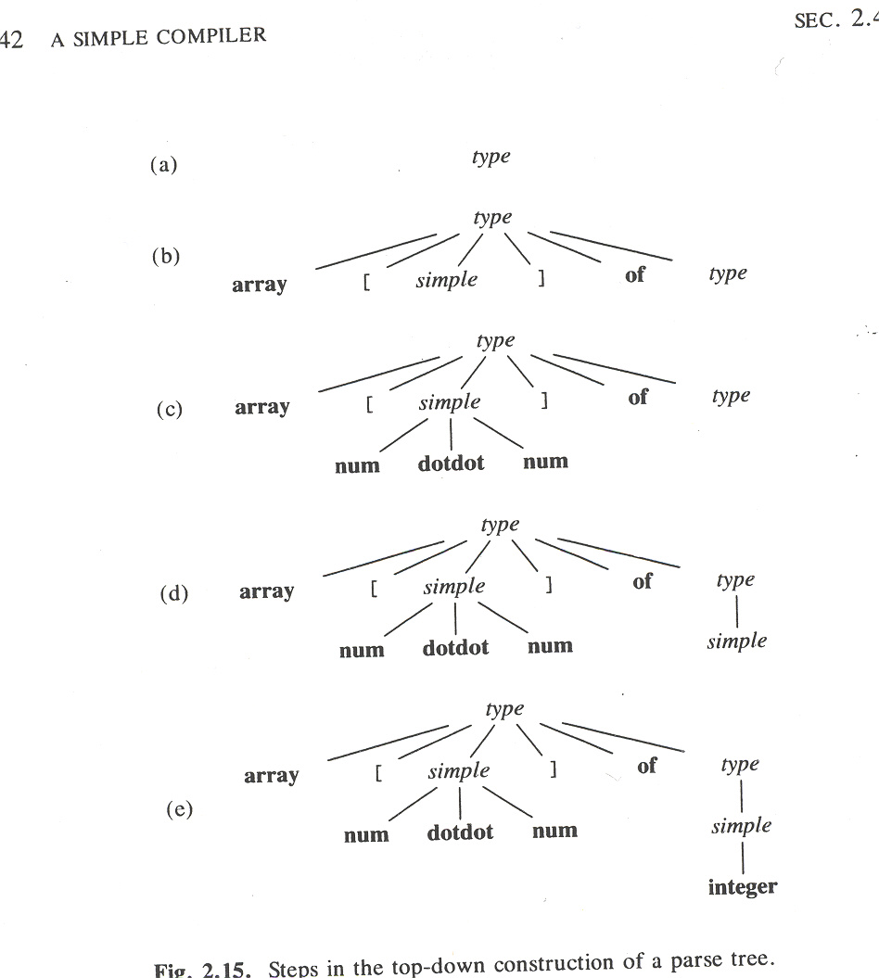
Steps in the top-down construction of a PT
Given the following Grammar:
type -> simple | ↑id | array [ simple ] of type
simple-> integer | char | num dotdot num
Start symbol
Parse the input string : array [ num dotdot num ] of integer
Notes:
type -> simple | ↑id | array [ simple ] of type
simple-> integer | char | num dotdot num

Slide 45
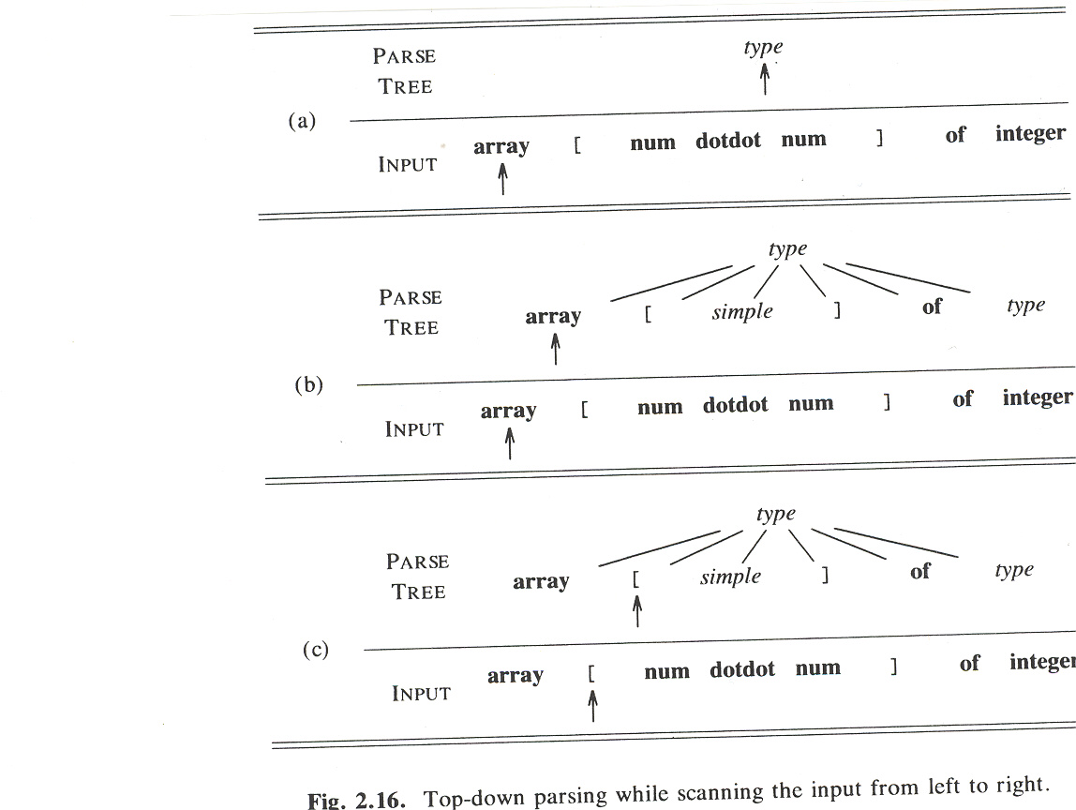
Top-down parsing scanning the input from left to right

Slide 46
Example: Trial and Error to select the right rule
The selection of a production for a non-terminal may involve some trail and error
Example :the following grammar defines the language {cabd, cad}
S → c A d
A → a b | a
First attempt: Suppose a parser is presented with input “cad”
S ⇒ c A d ⇒ c a b d
parser get stuck because, b does not match d
Parser needs to backtrack
Second attempts: Parser backtracks and selects another rule
S ⇒ c A d ⇒ c a d

Slide 47
Predictive Parsing (PP): Recursive-descent paring
Special form of recursive-descent parsing,
Uses the lookahead symbol to call the routine
Begins with a call to the routine for starting symbol (or goal symbol)
No backtracking is needed (good)
Does not handle left-recursive grammar (bad)

Slide 48
Designing a Predicative Parsing (PP)
Predictive parser (PP) is a program
Consists of a routine for every non-terminal
Each routine decides which production to use based on the look-ahead symbols in FIRST(α)
where
FIRST(α) = a set of terminals appearing as the FIRST symbols of one or more strings of terminals generated from α
Examples: simple-> integer | char | num dotdot num
FIRST (simple) = {integer, char, num}

Slide 49
FIRST(α)
The FIRST sets must be used if there are two or more productions
A→α
A→β
Recursive-descent parsing without backtracking demands FIRST(α) and FIRST(β) be disjoint
FIRST(α) ∩ FIRST(β) ≡ ∅
Lookahead symbol can be used to decide which production must be used:
If a lookahead symbol is in FIRST(α), then α can be used
If a lookahead symbol is in FIRST(β), then can β be used
Notes:
First Set: This set is created to know what terminal symbol is derived in the first position by a non-terminal.
For example, α → t β. That is α derives t (terminal) in the very first position. So, t ∈ FIRST(α).

Slide 50
Guidelines for implementing top-down parsers
Write a routine for each non-terminal in the Grammar
Call that routine whenever a production for the non-terminal is to be applied
See the example for type grammar
type -> simple |↑id | array [ simple ] of type
simple-> integer | char | num dotdot num

Slide 51
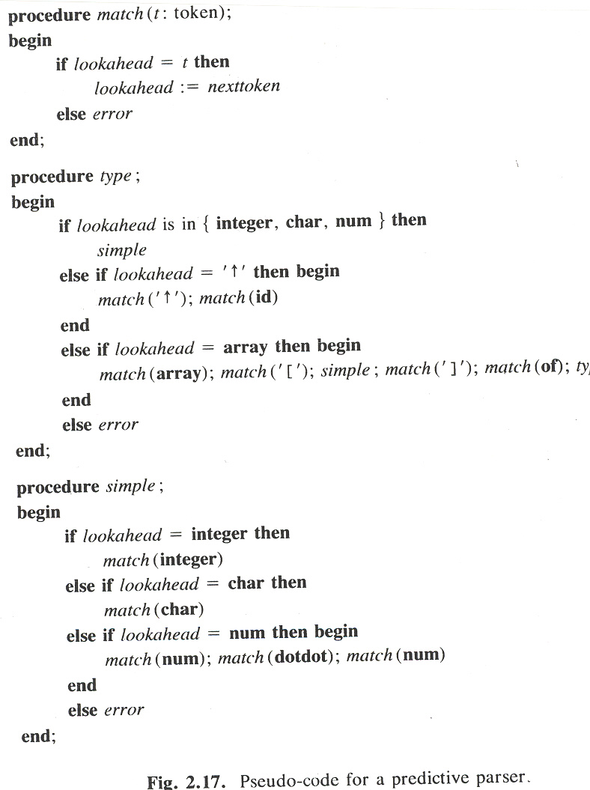
Pseudocode for Predictive Parser
1) type -> simple | ↑id | array [ simple ] of type
2) simple-> integer | char | num dotdot num

Slide 52
Left Recursion
A grammar becomes left-recursive if it has any non-terminal ‘A’ whose derivation contains ‘A’ itself as the Left-Most Symbol.
May cause a recursive descent parser to loop forever

Slide 53
Some examples
Example 1: Immediate left recursion
A => Aα | β
Example 2: Indirect-left recursion
S => Aα | β
A => Sd

Slide 54
Eliminating Left Recursion
Given the following rule:
A -> Aα |β
The left recursion can be removed
A-> β R
R-> αR|∈
The left-recursion elimination can be applied to Translation Scheme

Slide 55
Eliminating the indirect recursion
For the production set
S => Aα | β
A => Sd
First: expand A by substituting in A for S
S => Aα | β
A => Aαd | βd
Second: remove Immediate Left Recursion from A
A => βdR
R => αdR| ɛ
Final Result: Put them all together
S => Aα | β
A => βdR
R => αdR| ɛ

Slide 56
General technique for eliminating left recursion
Suppose A -> Aα |Aβ|ρ
Into
A-> ρR
R-> αR| βR| ∈

Slide 57
Elimination of let recursion infix-postfix
expr→ expr + term {print (‘+’) }|expr - term {print (‘-’) } |term
term→0 {print (‘0’) }
term→1 {print (‘1’) }
term→2 {print (‘2’) }
term→3 {print (‘3’) }
…
term→9 {print (‘9’) }

Slide 58
Figure 2.21 (eliminate left recursion)

Slide 59
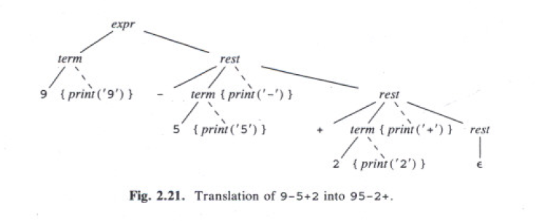
Translation of 9-5+2: going from left-to-right

Slide 60
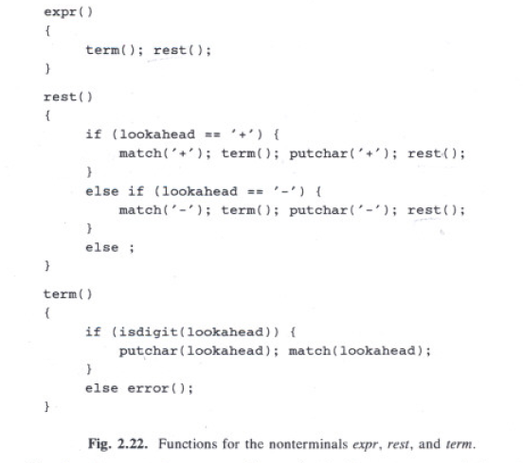
Implementation using tail recursion

Slide 61
Implementation using GOTO statement

Slide 62
Optimizing the translator: Iteration

Slide 63
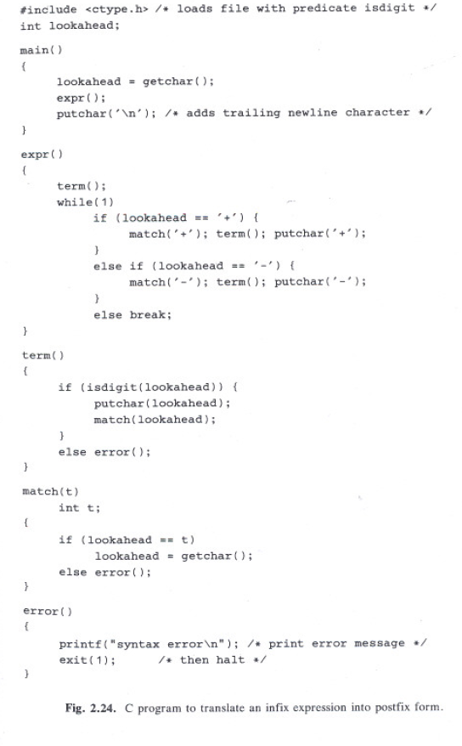

Slide 64
// expr →term rest
rest

Slide 65
Problems with Syntax Analyzers
Syntax analyzers receive their inputs, in the form of tokens, from lexical analyzers.
Lexical analyzers are responsible for the validity of a token supplied to the syntax analyzer.
Syntax analyzers have the following drawbacks
it cannot determine if a token is valid
it cannot determine if a token is declared before it is being used,
it cannot determine if a token is initialized before it is being used,
it cannot determine if an operation performed on a token type is valid or not.

Slide 66
Adding Lexical

Slide 67
Adding Lexical Analysis
Add lexical analysis to the translator
Reads and converts the input into a stream of tokens
These tokens will be analyzed by parser
Main features of lexical analyzer
Token Recognitions
Identifiers (e.g., count)
Keywords (e.g., IF/THEN, etc.)
Numbers (2222, etc.)
White Space Removal
White space (blanks, etc.)
Comments

Slide 68
Symbol table

Slide 69
c = getchar(); // call to getchar to read the next input char to c
ungetc (c, stdin); // call to ungetc pushes back the value of c onto the //standard input stdin

Slide 70
Revised infix-2-postfix grammar handling numbers and additional binary operators

Slide 71
C code extending the grammar to handle factor
factor→(expr) | {print (num.value)} num

Slide 72
How to handle comments and white space (blank)
Most Programming languages allow arbitrary numbers of white space or comments appear between tokens
To handle white space and comments, the following pseudocode can be used
for (;; t is next input char ) {
If (t is a blank or a tab) do nothing
Else if (t is newline) lineno = lineno + 1;
Else break;
}

Slide 73
C code for Lexer removing white space and collecting numbers

Slide 74
The symbol-table interface
Used for reading and writing of lexemes
Main operations
Insert (s, t)
Insert returns index of new entry for string s, token t
Lookup (s)
Looks up returns index of entry for string s, or if s is not found
where
s = string (e.g., position)
t = token (e.g., IF-symbol, MOD-symbol, etc.)

Slide 76
Handling Reserved Keywords
Symbol-table can be used to deal with any collection of reserved keywords
E.g., tokens div and mod with lexemes div and mod respectively
Initialize symbol table with keywords using the calls
Insert (“div”, div);
Insert (“mod”, mod);
For example, any lookup (“div”) will return div meaning that div cannot be used as an identifier

Slide 77
Pseudo-code for a lexical analyzer

Slide 78
Abstract Stack Machines and Intermediate Code
Front-end of compiler builds an Intermediate Code (IC)
How to generate IC?
3-addres, syntax tree, or stack-machines
We use stack for now
Stack is programmed with a reverse Polish instruction set
Compilers using stack machines are simpler and faster to build than compilers for other machines (e.g., Register-2-register)
Stack is called Last In First Out (LIFO) storage with two abstract operations:
push
pop

Slide 79
generating IC using stack
Stack provides
Set of Instructions
Data memories (rvalue, lvalue, etc)
Instructions set include
Integer arithmetic ( +, -)
Stack manipulation (push/pop)
Control flow ( Branches using IF/THEN)

Slide 80
Arithmetic Instructions
Basic operations
Addition
Subtraction
Complex operations
Can be implemented as a sequence of abstract machine instructions

Slide 81
Translation of Expressions based on Stack-machine
Code to evaluate an expression on a stock machine is closely related to postfix notation for that expression
The stack-machine code to evaluate E+F:
code to evaluate E || code to evaluate F || applies add operation
The translation simply can be done using TS or SDD

Slide 82
Simulation of postfix using stack
The evaluation for postfix starts from
Left-to-right
Push each operand onto the stack
When k-ary operator has been located
Its-leftmost-argument is k-1 positions below the top of stack
Its-rightmost-operand is the top of stack
Apply the operator to the top k-values by
Popping the operands
Pushing the result back onto stack

Slide 83
Example: 1 3 + 5 *
Evaluation of 1 3 + 5 *
Push 1
Push 3
Addition (pop the two topmost elements and add them together)
Push 4
Push 5
Multiply (pop the two topmost elements and multiply them)
Push 20 ( the result of the entire expression)

Slide 84
Translation expression: L-values and R-values
There is distinction between the meaning of identifier on the left and right sides of assignment statement
i := 5;
i := i + 1;
The right side (R-Value) corresponds values (e.g., integers)
The left side (L-Value) corresponds to address (i.e., the locations where the value should be saved)

Slide 85
Example: Translation of simple expression a + b in stack machine
Example of translating the expression a+b:
rvalue a // push the content of the data located at a
rvalue b // push the content of the data located b
+ // add their values by popping the two top most values // from stack and pushing their result back into the // stack

Slide 86
SUMMARY of Stack Manipulation Operations
Generic operations to access the data memory
Push v // pushes value v (constant) onto the stack
Rvalue L // pushes contents of data location L
Lvalue L // pushes address of data location L
Pop // pops up the value on top of stack
:= // the r-value on top is placed in the l-value below it and both are popped
Copy // push a copy of the top value on the stack

Slide 87
Control Flow statment: IF/THEN, WHILE
The stack machine executes instructions in linear fashion unless told to jump
Several options exist for specifying the targets of jumps:
The operand provides the target address
The operand specifies the relative distance, positive, negative
Labels can be used for targets

Slide 88
The control-flow instructions
Label L //jump target
Goto L //next instruction is a label L
Gofalse L // jump if the popped value is Zero
Gotrue L //jump if the popped value is nonzero
Halt // stop

Slide 89
Translation of IF Statements (SDD)
stmt→if exp then stmt1
{ out := newlable;
stmt.t := exp.t||
‘gofalse’ out||
stmt1.t ||
‘lable’out}
Code for expr
gofalse out
Code for stmt1
lable out

Slide 90
Translation of IF Statement using Translation Scheme
stmt→if expr { out:=newlable; emit (‘gofalse’, out);} then stmt₁ { emit (‘lable’, out);}
Note: emit is an example of semantic action
newlable is function which generates new label (e.g., L1, L2,etc).
The order of execution is from left to right on R.H.S as follows
1. Perform actions during parsing for expr
2. Out is a lable to be set by newlable
3. Print ‘gofalse stamen’
4. Perform actions during parsing for stmt1
5. Print label instruction

Slide 91
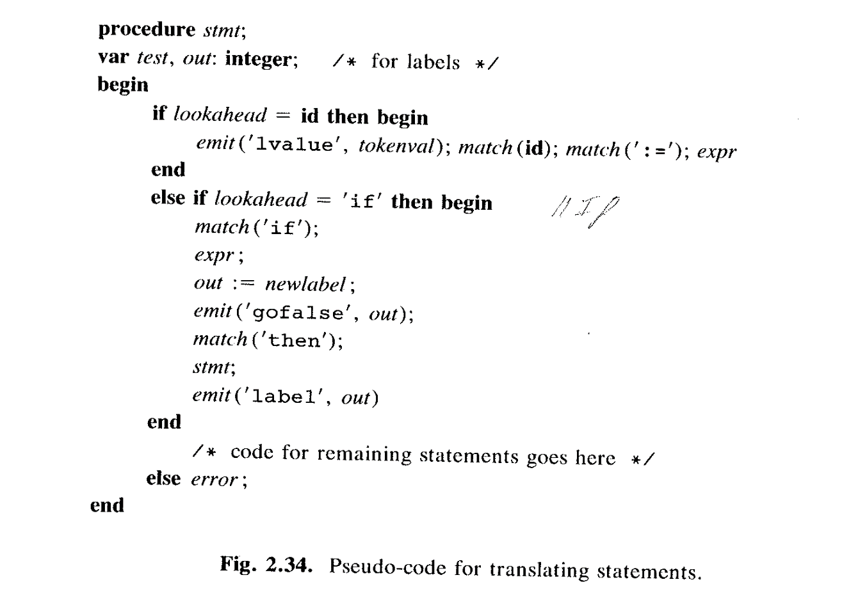
Pseudo-code for translating statements using stack machine (IC)
The actions during parsing of expr and stmt₁ should emit the code for these non-terminals

Slide 92
Putting All together for infix to postfix translator

Slide 93
SDD Recursion-free of infix2postfix translation

Slide 94
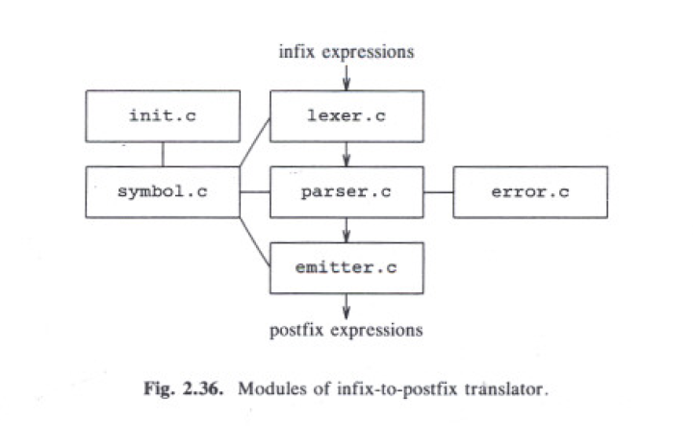
Putting all the modules together

Slide 95
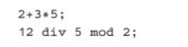
Putting them all together to build the infix2postfix transaltor
Try For Input source:

Slide 96
Quiz
Consider the CFG
S→ SS + | SS * | a
show how the string aa+a* can be generated by this grammar
built a parse tree for this string

Slide 97
Quiz (answer)
s
S
S
*
+
a
a
a

